Slide 1
Quantum Error Correction
The start of fault tolerance computing…
不正经讲师：理科宅Hunt

Slide 2
Fault Tolerance Computing
Simply speak, fault tolerance computing(容错计算) can produce correct answer even if error (fault) occurs.

Slide 3

Error types in Quantum Computing
Bit-flip error(位翻转错误): $\left|0\right\rangle ↦|1⟩$ or $\left|1\right\rangle ↦|0⟩$
Phase-flip error(相翻转错误): $α\left|0\right\rangle +β\left|1\right\rangle ↦α\left|0\right\rangle −β|1⟩$
$α\left|0\right\rangle +β\left|1\right\rangle ↦α\left|0\right\rangle −β|1⟩$ and $α\left|0\right\rangle +β\left|1\right\rangle ↦−α\left|0\right\rangle +β|1⟩$ are the SAME error, since we can factor out -1 ignore the global phase, so
$$−α\left|0\right\rangle +β\left|1\right\rangle =−(α\left|0\right\rangle −β|1⟩)≡α\left|0\right\rangle −β|1⟩$$

Slide 4
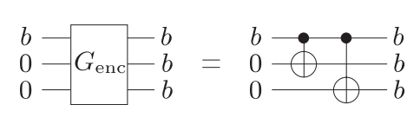

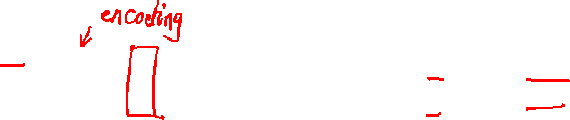
Classical bit-flip correction – Three-bit code
We assume at most 1 bit-flip can occur within each bit (In fact, it is not correctable if more than 1 bit-flip occurs at the same time).
The way to correct bit-flip error is by copying the bit to extra bits(ancilla).
We can determine what operations to perform according to the ancilla bits.
Encode b to ancilla by using 2 CNOT gates. Abstract this action by $G_{enc}$ gate.

Slide 5
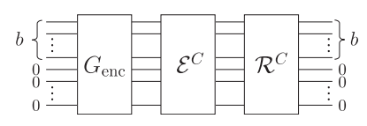
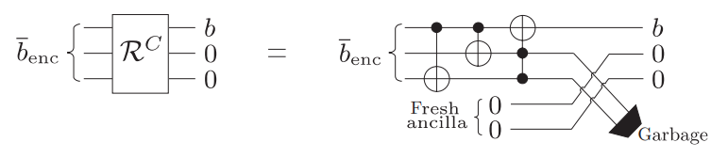

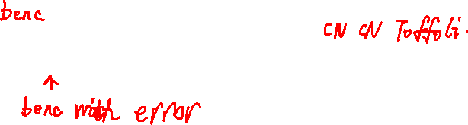
Classical bit-flip correction – Three-bit code
Abstract the classical bit-flip error to a gate, call it $ε^{C}$
Abstract the classical bit-flip correction to a gate, call it $R^{C}$
Before error corrupt the bit $b$, encode it into ancilla bits by $G_{enc}$. We then apply Recovery gate to the corrupted bits.
General error correction procedure
Three-bit Recovery gate

Slide 6

Example
Let $b=0$, so we have $b_{enc}=000$ after encoding. Now bit-flip error happens, recover $b$ by applying recovery gate.
Suppose bit-flip occurs on 1st bit, then the corrupted data is ${\overline{b}}_{enc}=100$

Slide 7
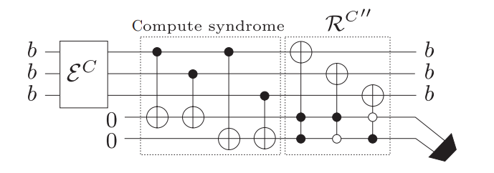

Fault Tolerance circuit
The three-bit code is good. But at the end of recovery we decodes the data ($bbb↦b00$). Next time if we want to do correction again, we need to do encoding again ($b00↦bbb$)…
Here is a way to do recovery without decoding. Hence we can do recovery later, hence the circuit is fault tolerant.
The hollow circles in the controlled gates in the circuit correspond to a 0-control (i.e. conditioned on that control bit being 0).

Slide 8

Example
Let $b=0$, and bit-flip error happened on 2nd bit. Recover $b$.

Slide 9
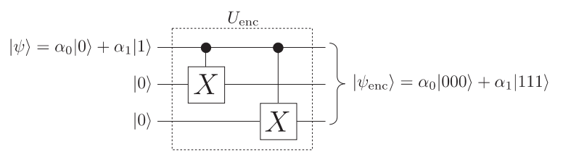
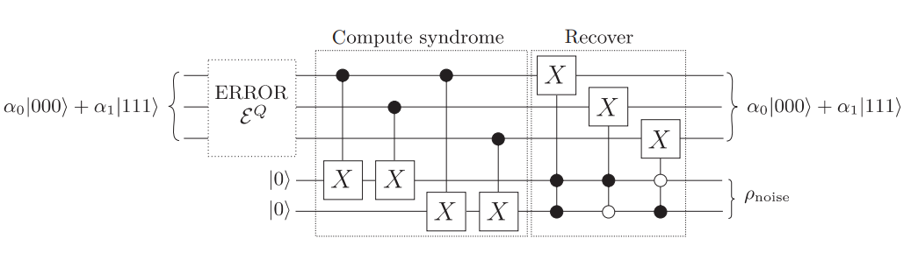

Quantum bit-flip correction
It seems No-cloning theorems tells us encoding does not work. BUT we can bypass it by using 2 CNOT gates.
Others are the same.

Slide 10

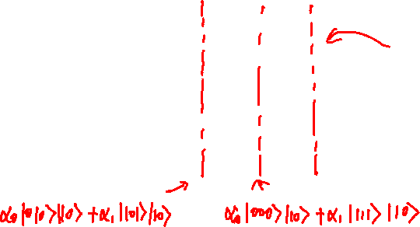


Example – An exercise for you as well
Let $\left|ψ\right\rangle =α_{0}\left|0\right\rangle +α_{1}|1⟩$, and assume the 2nd bit is flipped, recover it.

Slide 11
Summary
By copying information to ancilla bits, we can make computation fault tolerance.

